Slide 1
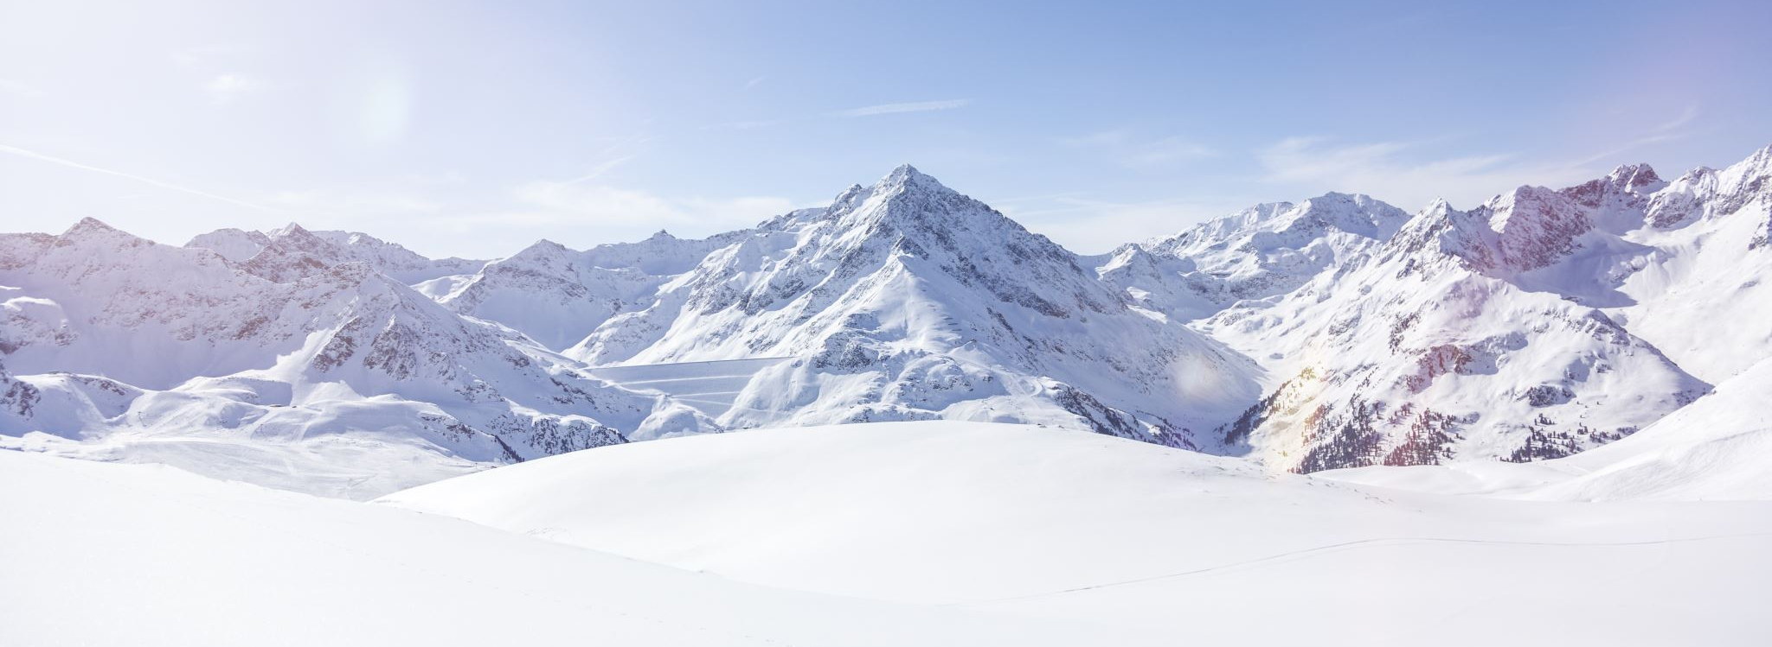
Big Mountain Resort
Allen Ansari
Fall 2020

Slide 2

Agenda
Problem identification
Recommendation and key findings
Modeling results and analysis
Summary and conclusion

Slide 3
problem identification
Install new chai lift
$1.5 million operation cost
New ticket price strategy to increase revenue
Keeping ticket price below average price of the resort in same market segment
Reducing cost

Slide 4
Recommendation and key finding
Increase by $4.48 which increase revenue by $7.84 million
Permanently closing up to 10 of the least used runs
Ticket price down by $1.81 and revenue will be decreased by $3170290
Need more information like operation cost to support this scenario
Adding a run, increasing the vertical drop by 150 feet, and installing new chair lift
Increases ticket price by $8.61
Expected increasing the revenue to $15065471
Adding a run, increasing the vertical drop by 150 feet, and installing new chair lift adding 2 acres of snow making
ticket price increase by $9.9
increasing revenue by $1732271
ncreasing the longest run by 0.2 miles (no changes)

Slide 5
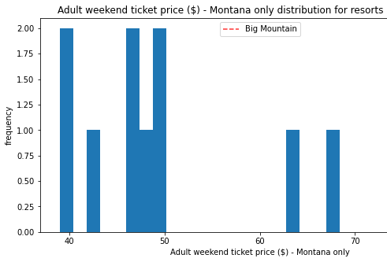
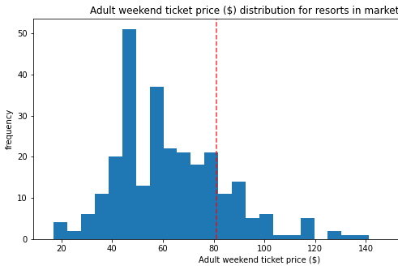
Modeling results and analysis

Slide 6
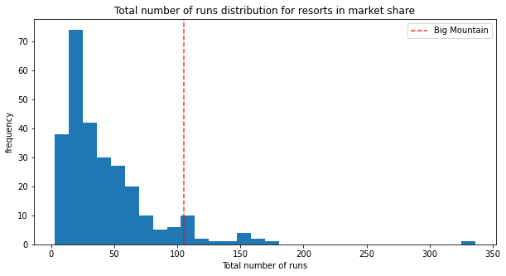
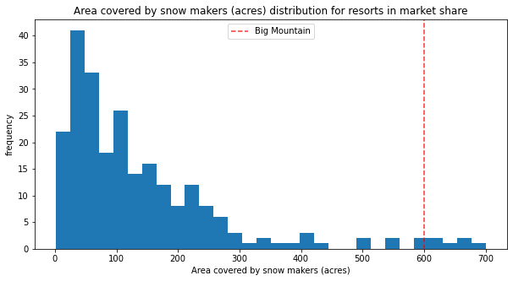
Modeling results and analysis

Slide 7
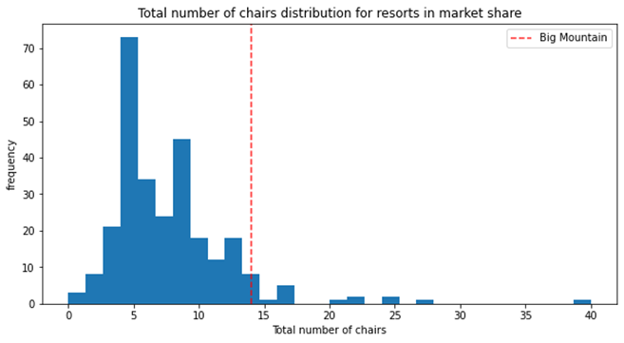
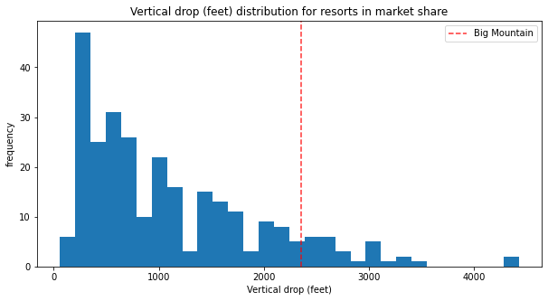
Modeling results and analysis

Slide 8
Summary and conclusion
Increase ticket price by $4.48
Adding a run, increasing the vertical drop by 150 feet, and installing new chair lift
More information like operation cost for each facility
implementing API to check other solutions

